Slide 1
Scientific and Statistical Visualization
Introduction

Slide 2
visualization
pictures
The purpose of computing is insight, not numbers.
Richard Wesley Hamming
Card, Mackinlay, Shneiderman

Slide 3

vi·su·al·i·za·tion
1. Formation of mental visual images
2. The act or process of interpreting in visual terms or of putting into visible form

Slide 4
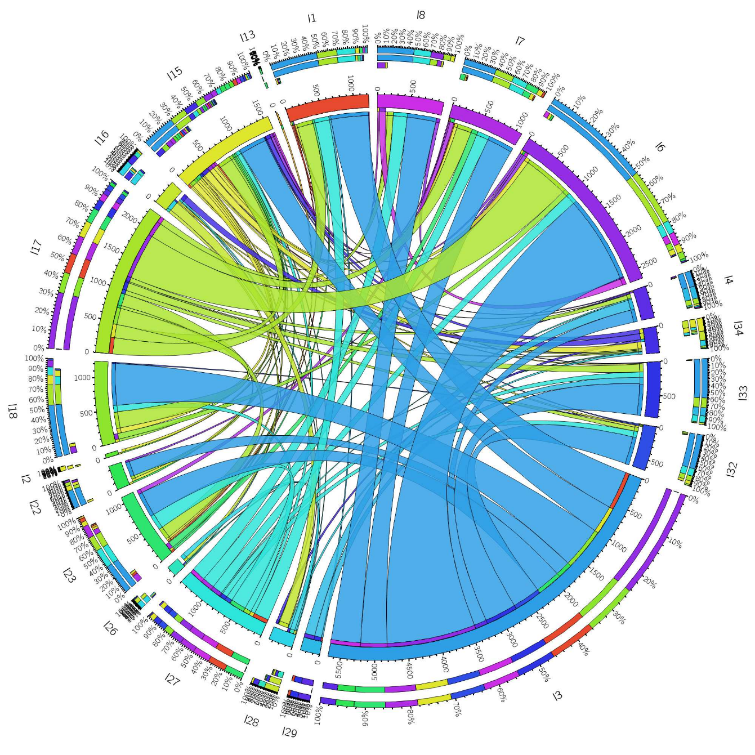
Visualization
Visualization is the process that transforms (abstract) data into interactive graphical representations for the purpose of exploration, conﬁrmation, or presentation.

Slide 5
Good Data Visualization…
Makes Data Accessible
Combines Strengths of humans and computers
Enables insight
Communicates

Slide 6
“Visualization is really about external cognition, that is, how resources outside the mind can be used to boost the cognitive capabilities of the mind.” - Stuart Card

Slide 7
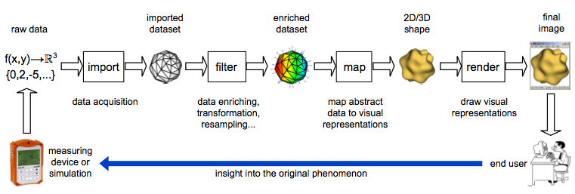
The Visualization Pipeline
transform raw data into insightful answers
sequence of steps
data acquisition (conversion, formatting, cleaning)
data enrichment (transformation, resampling, filtering)
data mapping (produce visible shapes from data)
rendering (draw and interact with the shapes)

Slide 8
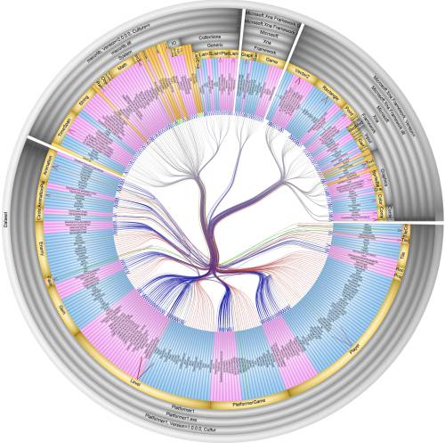
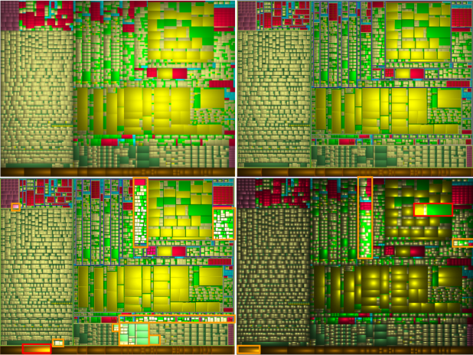
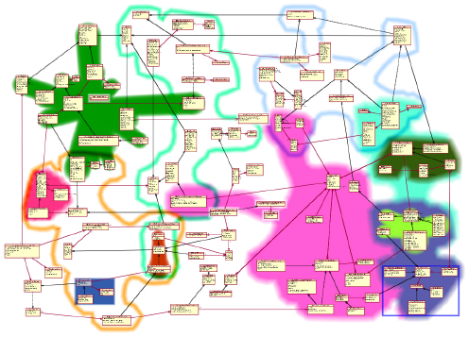

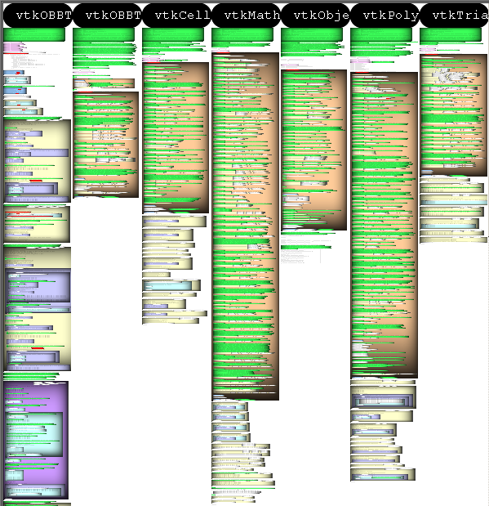
2. Software Structure Visualization
www.cs.rug.nl/svcg

Slide 9
Software Visualization
Definition:
“Software visualization is concerned with the static or animated 2D or 3D visual representation of information about software systems based on their structure, history, or behavior in order to help software engineering tasks” [Diehl, 2006]
For whom:
developers: understand large code bases quicker develop and refactor quicker
testers: create and manage large test suites quicker invest testing effort more efficiently
architects: understand very large software systems compare code with design documents reverse-engineer structure from code
managers: overview long-duration projects correlate quality with process decisions
business: assess quality of process and product decisions support in/outsourcing activities communicate with technical stakeholders easily
Goals:
reduce cost/time, increase quality and productivity!
www.cs.rug.nl/svcg

Slide 10
Software Visualization – Really needed?
Surveys:
software industry forecast: 457 billion $ (2013), 50% larger than in 2008 [www.infoedge.com]
comparison: total US health care spending 2.5 trillion $ (2009) [www.usatoday.com/news/health]
80% of development costs spent on maintenance [Standish’84, Corbi’99]
50% of this is spent for understanding the software!
Practice:
40% engineers find SoftVis indispensable, other 42% find it not critical [Koschke ’02]
“visual” tools or tool plugins become increasingly accepted in software engineering
Visual Studio, Eclipse, Rational Rose, Together, JReal, DDD, …
See new Visual Studio 2010 dependency visualization!
Research:
Software visualization is now an established research area
own events: ACM SoftVis, IEEE VISSOFT
related events: InfoVis, VAST, ICSE, I(W|C)PC, WCRE, OOPSLA, SIGSOFT, ECOOP, …
A few billion of lines of code later: Using static analysis to find bugs in the real world (A. Bessey et al.), CACM, 2010
Software visualization in software maintenance, reverse engineering, and re-engineering: a research survey (R. Koschke), JSME, 2003
Measuring the ROI of software process improvement (R. van Solingen), IEEE Software, 2004
The paradox of software visualization (S. Reiss), IEEE VISSOFT, 2005
The end of line for software visualisation? (S. Charters, N. Thomas, M. Munro), IEEE VISSOFT, 2003
www.cs.rug.nl/svcg

Slide 11
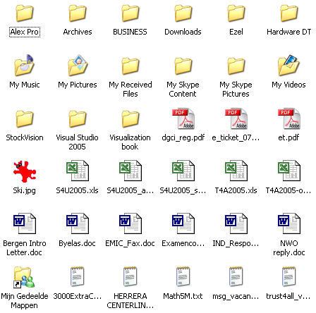
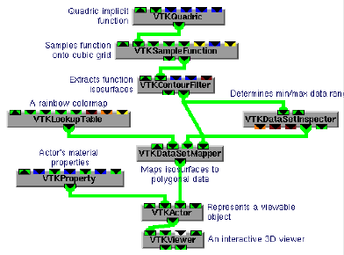

Software Visualization vs Visual Programming
software
visualization
tool
is examined by
creates
is analyzed by
software visualization
The software
visual programming
The user
generates
creates
visual
programming
tool
is read by
The tools
www.cs.rug.nl/svcg

Slide 12
Software Visualization vs Visual Programming
Visual Programming
usually for small programs
mostly used in forward engineering (FE)
usually at ‘component’ level
is still not very popular
complemented by ‘classical’ textual programming
can work at several levels of details
quite well integrated in the engineering pipeline
Software Visualization
for small…huge programs
most used in reverse engineering (RE)
at line-of-code…system level
starts becoming quite popular
complemented by ‘classical’ code text reading
can work at several levels of detail
not yet tightly integrated in the engineering pipeline
We’ll talk about software visualization, not visual programming
www.cs.rug.nl/svcg

Slide 13
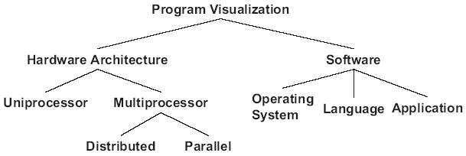
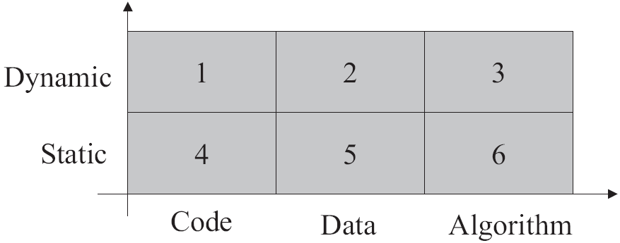
Software Visualization Taxonomies
1. Matrix of techniques [Myers, 1990]
data dynamics
type of data
2. Technique hierarchy [Oudshoorn et al., 1996]
3. Recent taxonomies [Diehl, 2006; Lanza and Marinescu, 2007]
structure visualization
behavior visualization
evolution visualization
simple and clear, so we’ll use this!
www.cs.rug.nl/svcg

Slide 14
Software Visualization Pipeline
Software analysis
software
engineering
software
data
data
acquisition
internal
data
data
filtering
design
development
testing
maintenance
static analysis
dynamic analysis
debugging
evolution analysis
graph extraction
metric computation
dataflow analysis
control flow analysis
insight,
decisions
enriched data
Software visualization
human
interpretation
image
graphics rendering
visual
representations
data mapping
graph layouts
attribute mapping
graph drawing
texture mapping
antialiasing
interaction
The two sub-pipelines are typically weakly connected (very unfortunately)
www.cs.rug.nl/svcg

Slide 15
Software Data Acquisition
Application
Data types
Data acquisition techniques
Structure
visualization
source code, functions,
classes, packages,
components
code parsing & fact extraction,
XML-based interfaces, reflection mechanisms
Behavior
visualization
program traces,
profiling logs, memory dumps
debuggers, profilers, instrumenting code, logging,
reflection mechanisms
Evolution
visualization
document repositories,
mail archives
repository browsers & APIs,
custom data-mining tools,
code-to-code diff tools
Software data acquisition: hugely complex!
static analysis: relatively easy for C#/Java, extremely hard for C/C++ or incomplete code
repository analysis: unstandardized formats, tools, APIs (SVN, CVS, Synergy, ClearCase, …)
dynamic analysis: costs time, may require source code
variability: huge number of tool/language/platform/dialect variations
scale: a serious issue (C++ Hello world: 65K LOC, 200 K symbols, 80 K relations)
Good analysis: >50% of the total pipeline effort!
More info: see www.cs.rug.nl/svcg/SoftVis (tools, papers, case studies, demos)
www.cs.rug.nl/svcg

Slide 16
SoftVis vs InfoVis
Similarities:
both deal with non-spatial, multivariate, relational, non-interpolable, datasets
large datasets (graphs/tables of millions of elements, tens of attributes/element)
users are typically not visualization experts
Differences:
structure and attribute complexity arguably larger than in InfoVis
resampling arguably more difficult (recall: change one character in a source file…)
semantics is harder to capture, show, and see!!!
SoftVis users arguably more technique-savvy than InfoVis users
tools and technical jargon easily accepted
expectancies are however higher
hard to penetrate into the programmers’ culture (‘I only use emacs!’)
embedding SoftVis in the complex software engineering pipeline
‘just read a data file’ golden age is gone
perfect tool integration demanded (editors, compilers, profilers, visualizations, …)
www.cs.rug.nl/svcg

Slide 17
Software structure visualization
Goal:
get insight in how a program is structured, from code lines up to modules and packages
different levels of detail = different visualizations
code lines
containment relations (usually)
can also be association relations (e.g. provides, requires, uses, calls, owns, …)
functions
classes
files
components
packages
level of
complexity
applications
www.cs.rug.nl/svcg

Slide 18
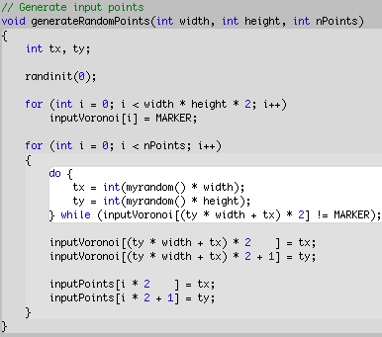
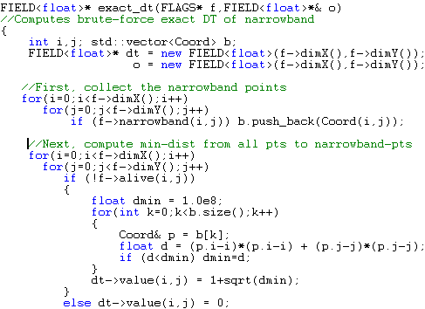
Software structure visualization
Source code
show code in structured way, helps understanding purpose
lexical highlighting: show code type
indentation: show structure
lexical highlighting (Visual C++ 9.0)
syntax highlighting (Xcode 2.0)
scalability: limited by font size
expressivity: typically limited by complexity of lexical constructs
implemented by most modern development tools
www.cs.rug.nl/svcg

Slide 19
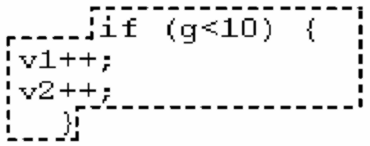

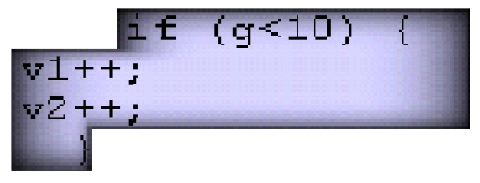
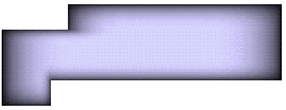
Source code structure
Syntax highlighting
more structure:
generalize lexical highlighting to full code syntax
adapt shaded cushions idea from treemaps to code blocks
source
code
syntax tree
+
cushion
texture
cushion
profile f(x)
border size x
G. Lommerse, F. Nossin, L. Voinea, A. Telea, The Visual Code Navigator: An Interactive Toolset for Source Code Investigation, IEEE InfoVis, 2005
www.cs.rug.nl/svcg

Slide 20
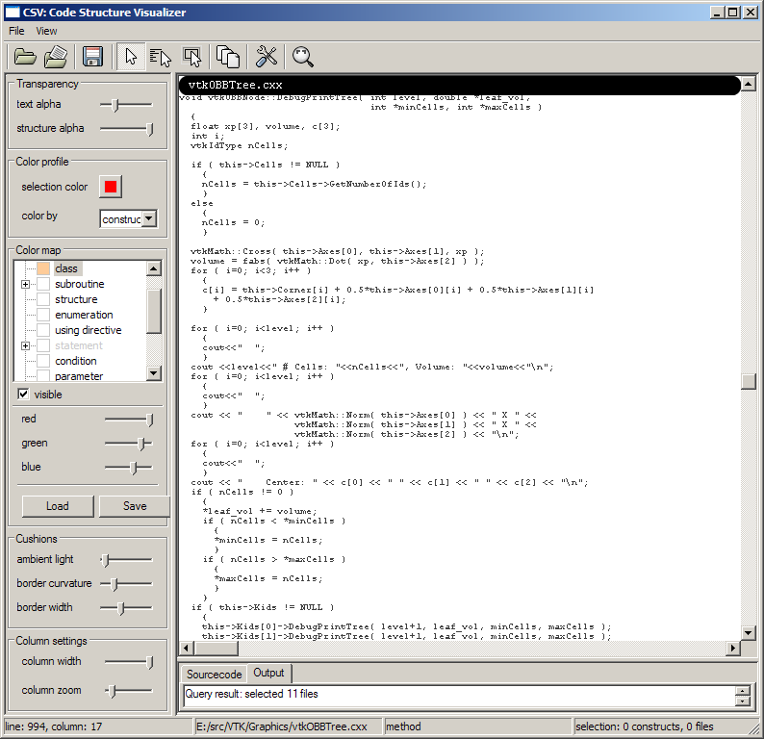
Source code structure
classical code editor
indentation shows some structure
Images from CSV tool (www.cs.rug.nl/svcg/SoftVis/VCN)
www.cs.rug.nl/svcg

Slide 21
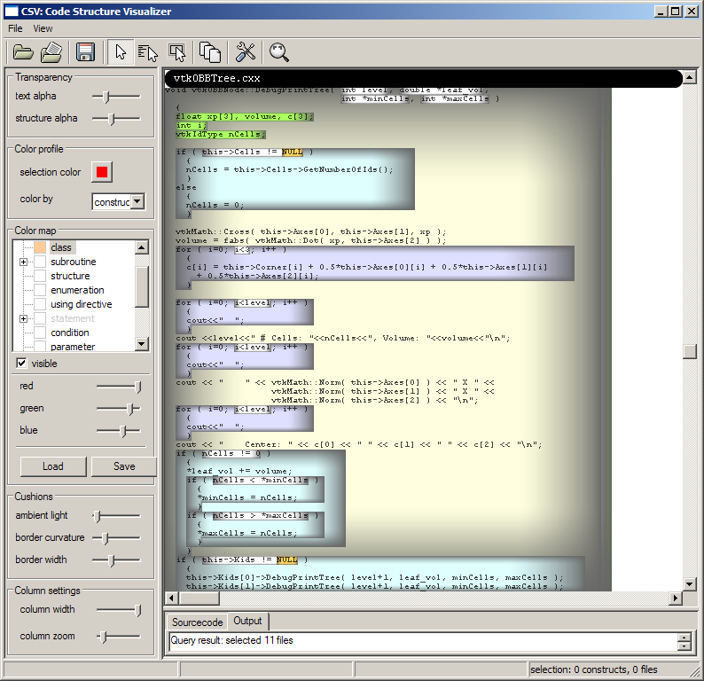
Source code structure
blend in structure cushions…
color shows construct type (functions, loops, control statements, declarations, …)
Images from CSV tool (www.cs.rug.nl/svcg/SoftVis/VCN)
www.cs.rug.nl/svcg

Slide 22
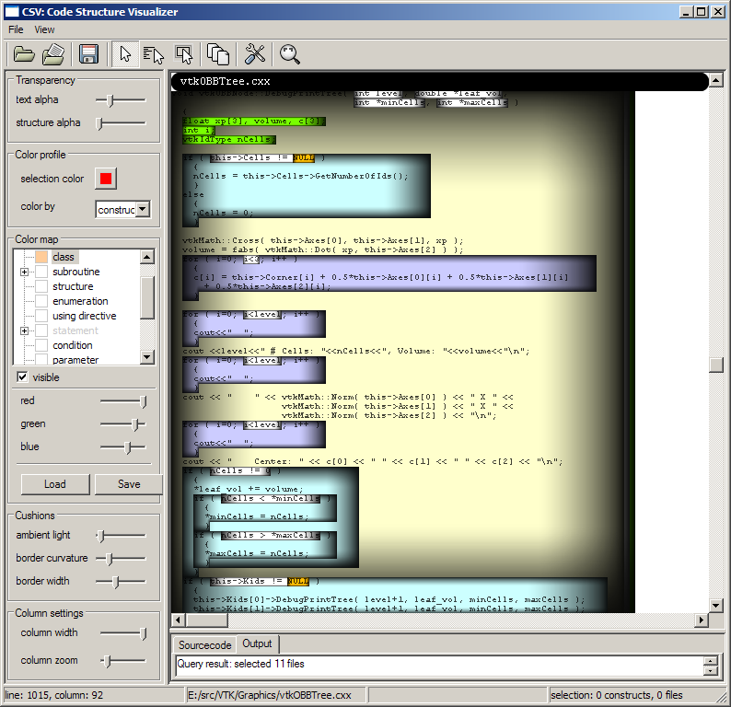
Source code structure
more structure cushions…
Images from CSV tool (www.cs.rug.nl/svcg/SoftVis/VCN)
www.cs.rug.nl/svcg

Slide 23
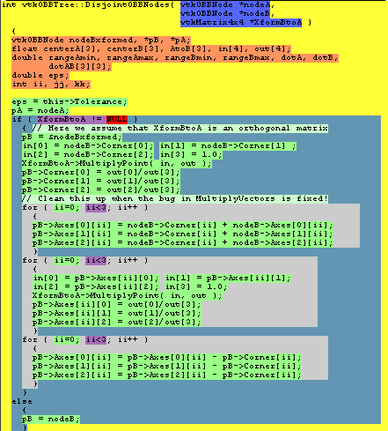
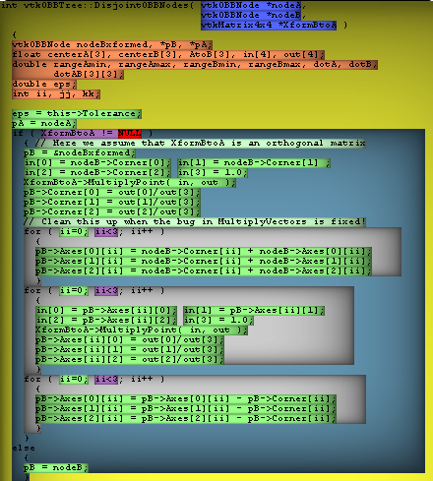
Source code structure
cushions generalize syntax highighting
‘flat’ syntax highlighting
‘cushioned’ syntax highlighting
Images from CSV tool (www.cs.rug.nl/svcg/SoftVis/VCN)
www.cs.rug.nl/svcg

Slide 24
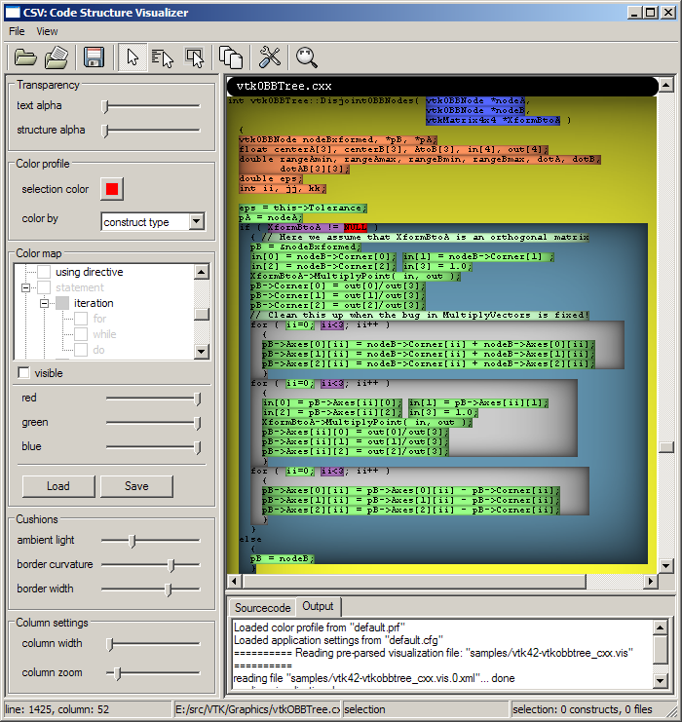
Source code structure
Brushing
show details on demand as function of the mouse pointer
widespread concept in InfoVis
move the mouse somewhere…
Images from CSV tool (www.cs.rug.nl/svcg/SoftVis/VCN)
www.cs.rug.nl/svcg

Slide 25
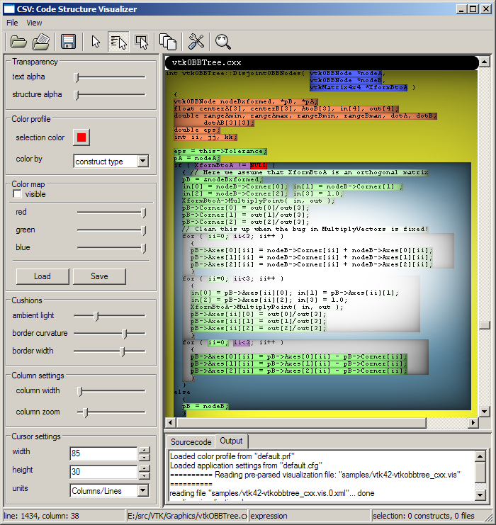
Source code structure
Brushing – spotlight cursor
fade out cushions as function of distance to mouse pointer
easy to do: blend a radial transparency texture
bring the text around in focus…
Images from CSV tool (www.cs.rug.nl/svcg/SoftVis/VCN)
www.cs.rug.nl/svcg

Slide 26
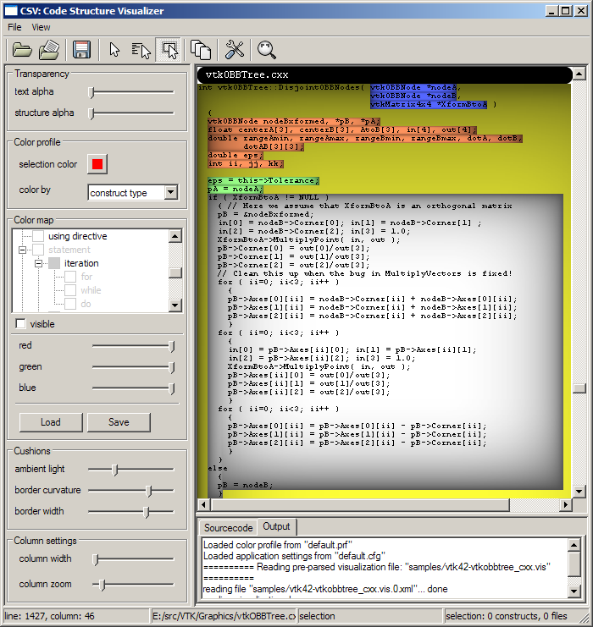
Source code structure
Brushing – structure cursor
highlight (desaturate) cushion under mouse
emphasizes structure
…of focus on a whole syntactic block
Images from CSV tool (www.cs.rug.nl/svcg/SoftVis/VCN)
www.cs.rug.nl/svcg

Slide 27
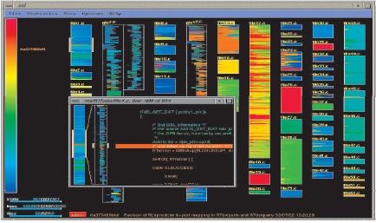
Source code structure
Dense pixel techniques
how to show 10000 lines of code on one screen?
adapt table lens idea
zoom out text view (keep layout)
replace characters by single pixels
The SeeSoft tool from AT&T [Eick et al. ‘92]
zoomed-out code drawn as pixel lines
color shows code age
source code at usual font size
scales to ~50 KLOC on one screen
correlations between files become possible
syntactic structure not emphasized
www.cs.rug.nl/svcg

Slide 28
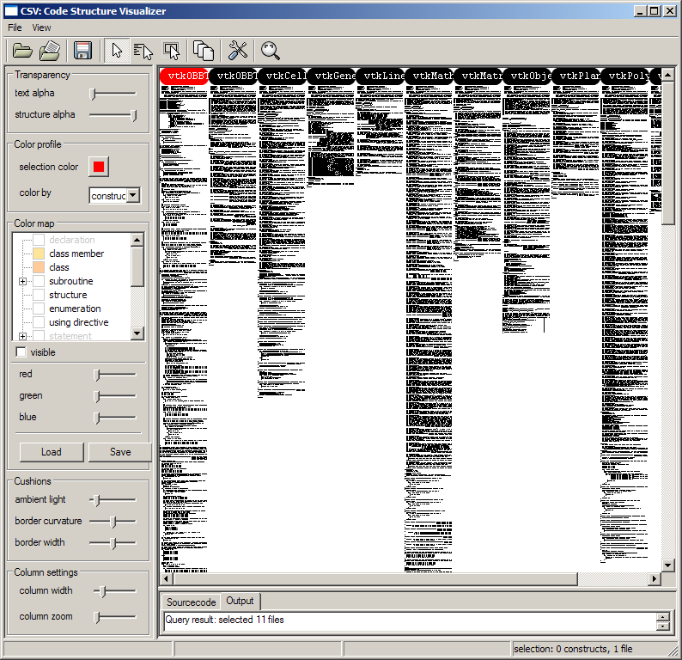
Source code structure
Dense pixel techniques
good to show data attributes (code age, bugs, quality metrics, …)
does not show structure
VTK class library
1 C++ file
10 headers
~7000 lines
VTK library: www.kitware.org/vtk
www.cs.rug.nl/svcg

Slide 29
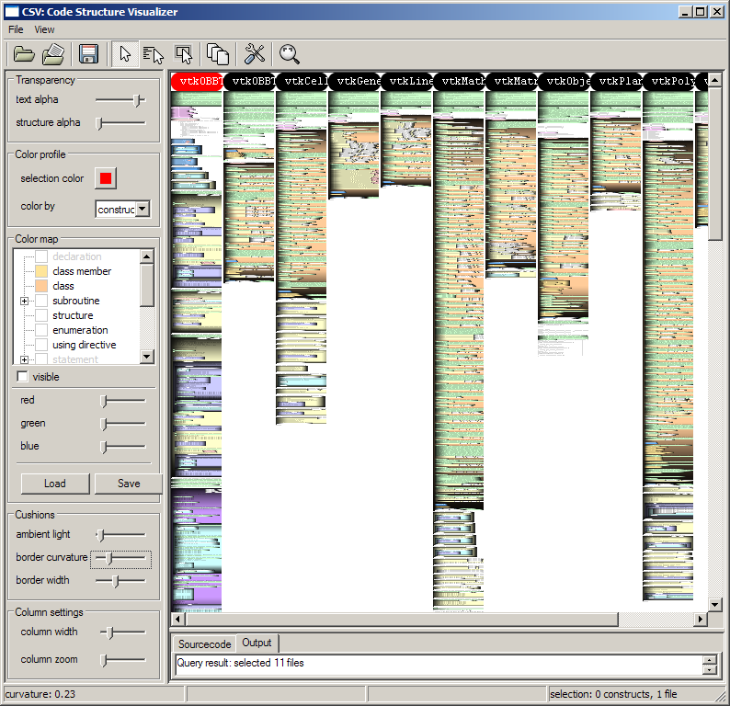
Source code structure
Add structure cushions
we start seeing things
source
headers
comment
class
iteration
if
…..
VTK library: www.kitware.org/vtk
www.cs.rug.nl/svcg

Slide 30
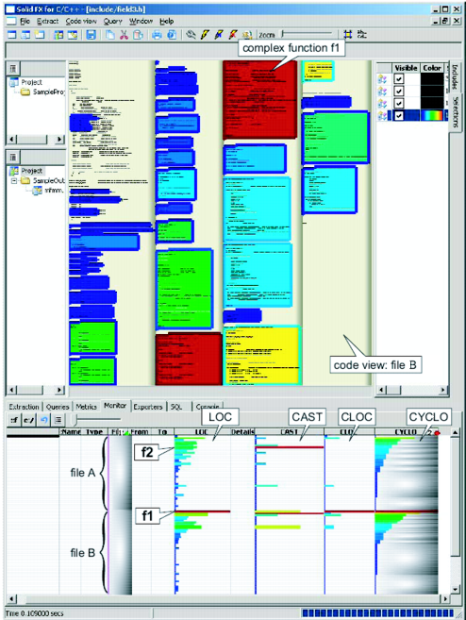
Source code structure
Enhancements
use two metrics per structure block
area color: code complexity [McCabe ‘76]
border color: number of casts
multiple correlated views
well-known InfoVis technique
table lens: find outliers (complex functions)
code view: get detailed insight
Example
find most complex functions in two files
check if they do many typecasts
A. Telea, L. Voinea, SolidFX: An Integrated Reverse-engineering Environment for C++, ACM SOFTVIS, 2008
Image created with the SolidFX tool (www.solidsourceit.com)
www.cs.rug.nl/svcg

Slide 31
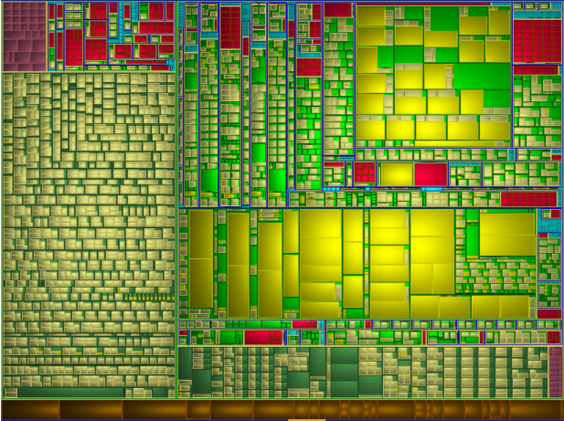
Interface structure
Interface: symbols organized as headers or namespaces
visualize with treemaps
cell size: #lines of code / #arguments (function) or #fields (compound type)
cell color: symbol type
‘public’ symbols in files
arguments
functions
fields
typedefs
global vars
files
files

Slide 32
Interface structure
Targeted questions:
- what kind of symbols are in a library’s headers?
- how are namespaces used in interface headers?
- does a header have a simple / uniform structure or not?
- are there heavy functions from a parameter-passing view?
C global
namespace
C++ std namespace
symbols
in file
brushed
file

Slide 33
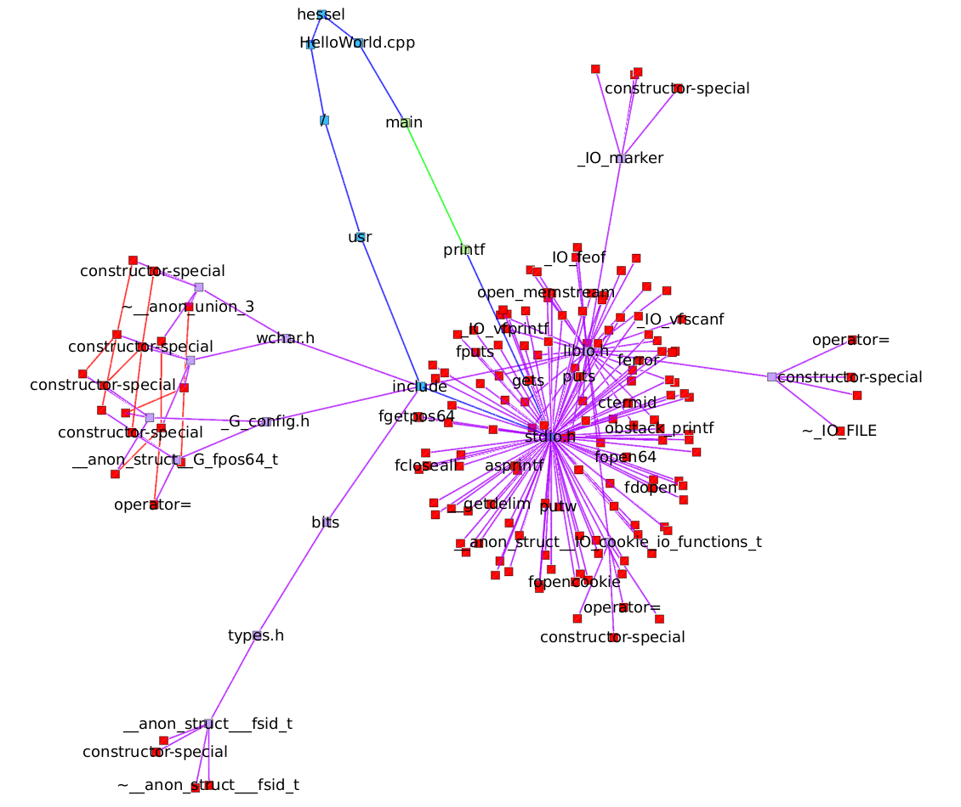
Compound digraphs
particular type of graphs, very frequent in SoftVis
two types of edges
containment – e.g. software hierarchy (files, modules, classes, functions, …)
association – e.g. software interactions (calls, inherits, uses, provides, requires, …)
how to visualize this?
Node-link layouts
(very) bad choice!
mix containment and association edges
occlusions, clutter
layout may change significantly if you
add/remove a few nodes/edges
change the layout parameters slightly
how to teach one to read such a layout?
Compound digraph of a C Hello World program
folders & files
functions
www.cs.rug.nl/svcg

Slide 34
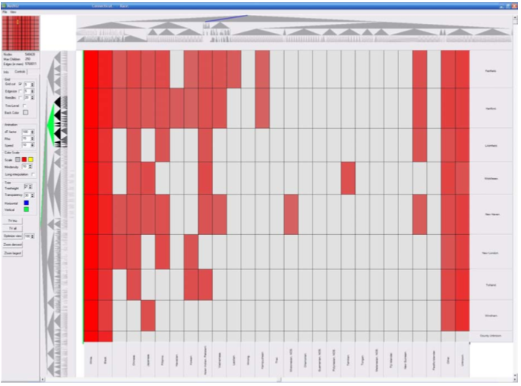
Compound digraphs
Use matrix plots (see lecture 1)
extend to show digraphs
containment – directed tree layouts on the x and y axes
association – matrix plot in the center (at user-chosen level of detail)
hierarchies can be navigated (collapse, expand, …)
J. Abello, F. van Ham, MatrixZoom: A Visual Interface to Semi-external Graphs, IEEE InfoVis 2004
www.cs.rug.nl/svcg

Slide 35
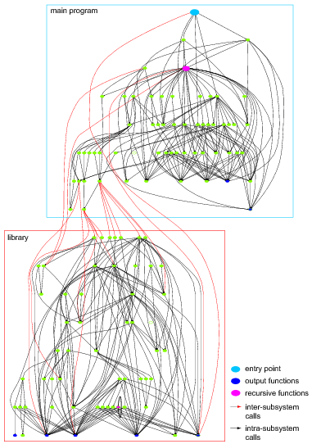
Compound digraphs
Nested layout
main idea
hierarchy: use spatial nesting (boxes in boxes)
association: use a suitable node-link layout
Bottom-up algorithm:
lay out each container node separately, using e.g. DAG layout methods
compute bounding box of container
use this size in the parent’s layout
visual nesting: strong, clear clue
spline edges can easily get cluttered
limited scalability

Slide 36
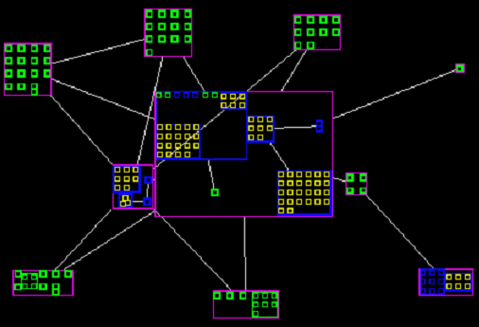
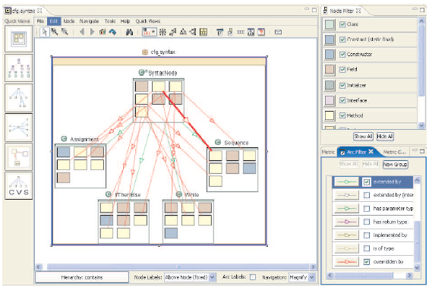
Nested layouts
Variations
change the intra-container layout (spring embedder, grid, …)
change the inter-container layout (same options as above)
SHriMP layout (Simple Hierarchical Multi-Perspective) [Storey and Muller ’95]
very popular, tens of tool implementations
limited scalability, clutter
SoftVision tool [Telea et al. ’02]
Creole tool (www.thechiselgroup.org/creole)
www.cs.rug.nl/svcg

Slide 37
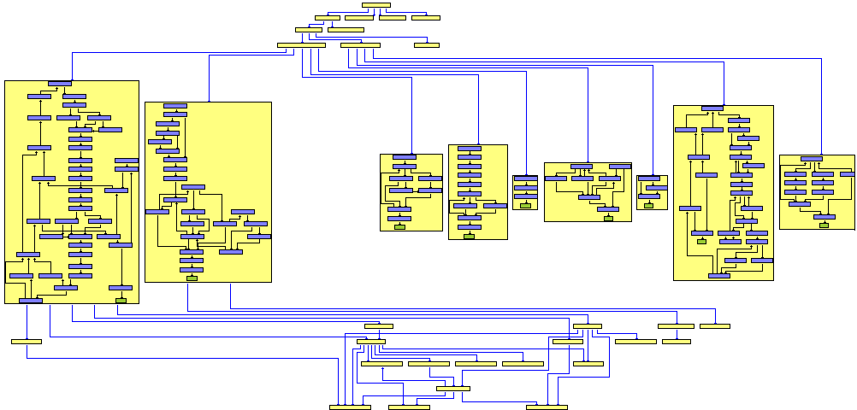
Nested layouts
Directed compound graphs
extend the hierarchical DAG layout [Sugiyama et al. ’81] to incorporate nesting
lay out children containers using original method
compute container bounding box
lay out parent level using sizes from children
route edges using orthogonal paths (eliminate crossings)
aiSee tool (www.absint.com/aisee)
one of the best compound digraph layouts in existence
clean and clear images, ‘engineering diagram’ look
can show 2..3 hierarchy levels simultaneously
G. Sander, Graph Layout through the VCG tool, Proc. Graph Drawing, 1995
Practical intro: T. Würthinger, Visualization of Program Dependence Graphs, http://ssw.jku.at/Research/Papers/Wuerthinger07Master

Slide 38
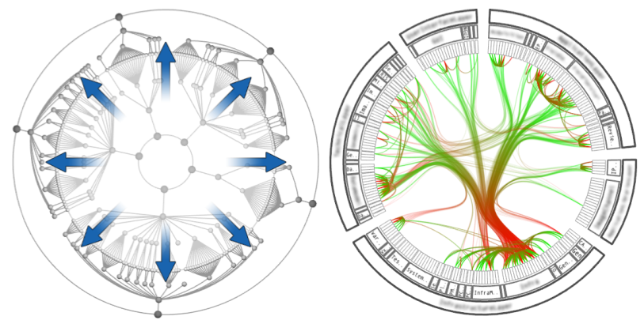
Compound digraphs – Hierarchically bundled edges
Hierarchically bundled edges (HEBs) [Holten, 2006]
containment: use a radial icicle plot
associations: use edge bundling
construct a classical tree layout from containment
map layout on radial plot
for each association edge
find the tree path connecting its end nodes
use path as control points to draw edge as spline
tree layout
hierarchically bundled edges
D. Holten, Hierarchical Edge Bundles: Visualization of Adjacency Relations in Hierarchical Data, IEEE InfoVis 2006
www.cs.rug.nl/svcg

Slide 39
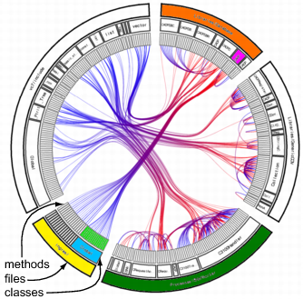
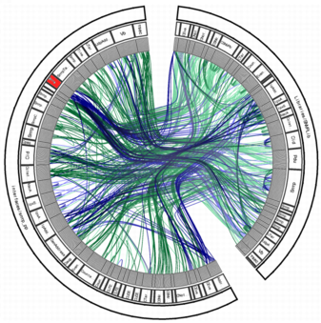
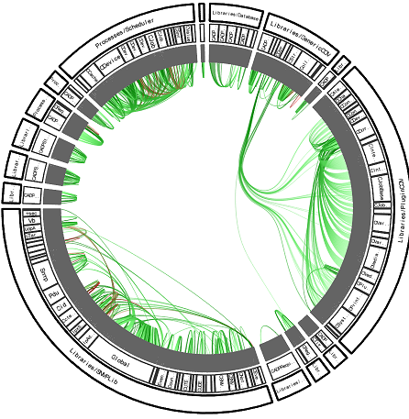
Hierarchically bundled edges
SoftVis application: modularity / coupling assessment
hard to quantify in a metric…
…but extremely easy to see
Modular system
Monolithic system
Decoupled system
blue = caller, red = called
all functions in the yellow file call the purple class
green file has many self-calls
blue = virtual, green = static functions
red class has many virtual calls (possible interface class)
many intra-module calls
few inter-module calls
typical for library software
www.cs.rug.nl/svcg

Slide 40
Hierarchically bundled edges
if associations are correlated with structure, HEBs shows this clearly!
images are intuitive for most users
edge overlaps instead of edge crossings!
overlaps communicate information
easy to visually follow a bundle
built-in scalability (bundling = free aggregation)
Structure and associations of C# system
Enhancements
node and edge color coding
edge alpha blending
saturated = high density = many edges
transparent = low density = few edges
aggregation and navigation
collapse and expand nodes
replace multiple edges by single one (like in NodeTrix, see lecture 1)
shaded hierarchy cushions
emphasize structure
Image generated with SolidSX tool (www.solidsourceit.com)
www.cs.rug.nl/svcg

Slide 41
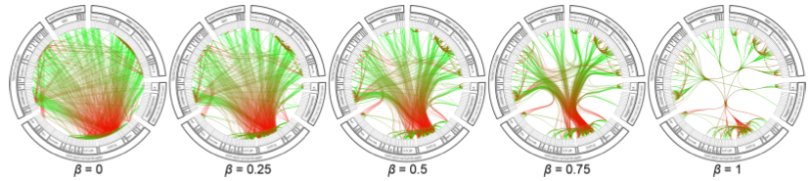
Hierarchically bundled edges
Bundling strength
vary spline fitting factor β to tree layout
continuous scale from straight lines to tight+compact bundles
trade-off between crossings and overlaps (overlaps are good, crossings are bad..)
www.cs.rug.nl/svcg

Slide 42
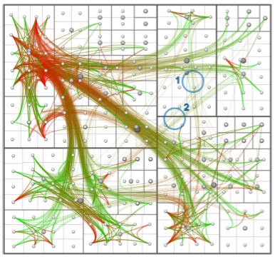
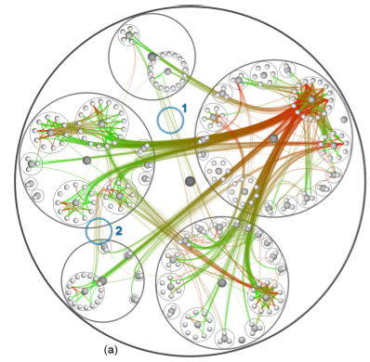
Hierarchically bundled edges
Layout variations
HEBs work in principle for other layouts than radial plots
however, the trees used for edge routing are easiest/best mapped on radial plots
squarified treemap
bubble layout
www.cs.rug.nl/svcg

Slide 43
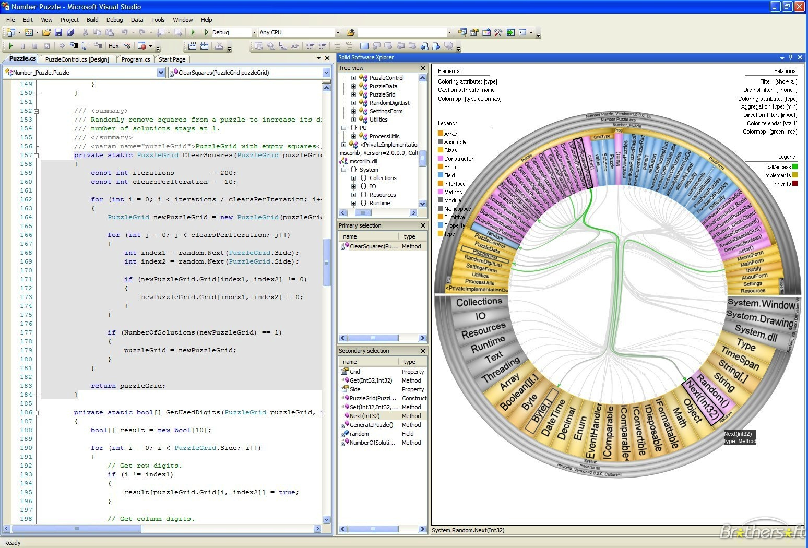
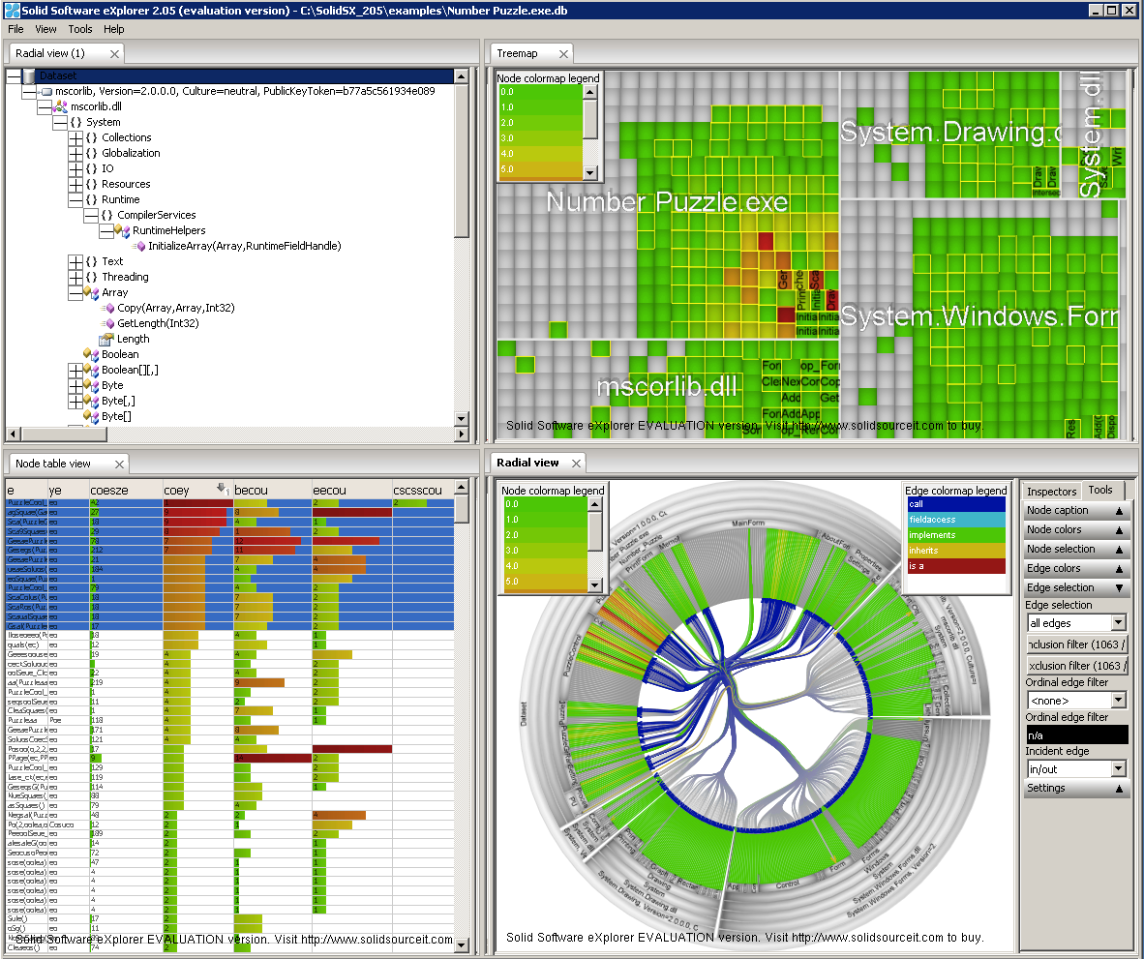
Multiple views (again)
Code view
SolidSX tool (www.solidsourceit.com)
Tree browser
Treemap
Table lens
HEB view
www.cs.rug.nl/svcg

Slide 44
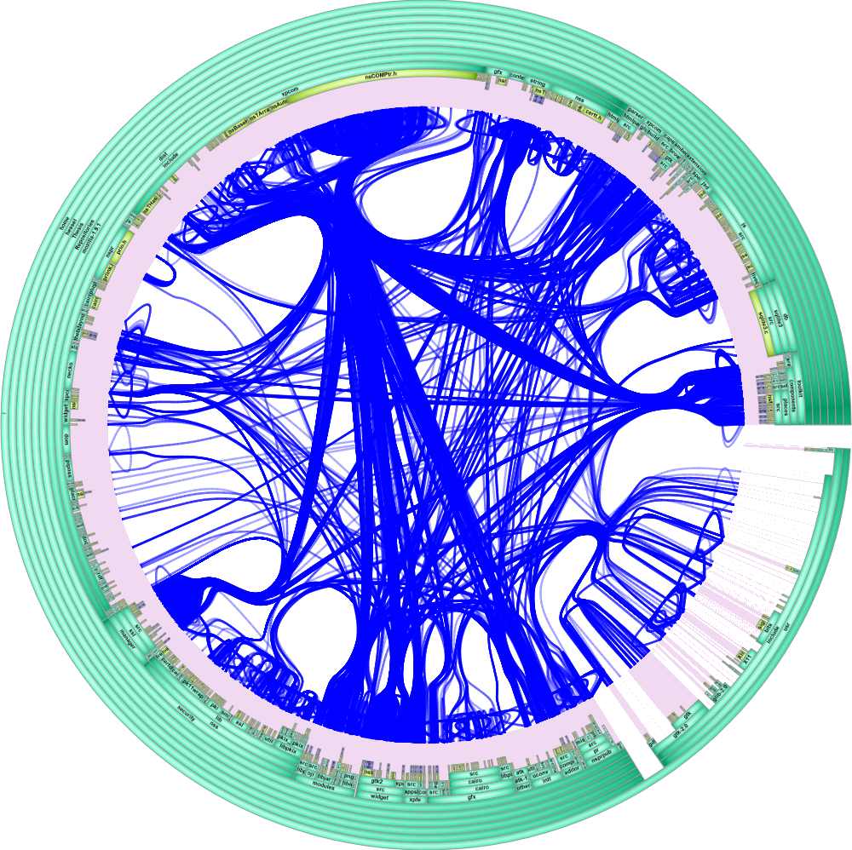
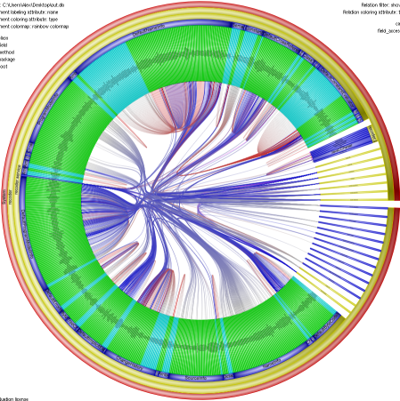
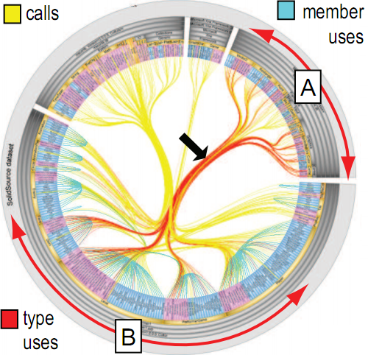
HEB limitations
HEB is perfect for compound digraphs, or.. ?
weak or missing hierarchy data
clutter is still a problem
overlapping bundles of different types
very large datasets
how to visually follow a bundle?
very large graph
weak hierarchy
overlap ambiguities
Large graph: Mozilla Firefox calls, 1.479.817 LOC, 102.969 nodes, 809.272 edges
www.cs.rug.nl/svcg

Slide 45
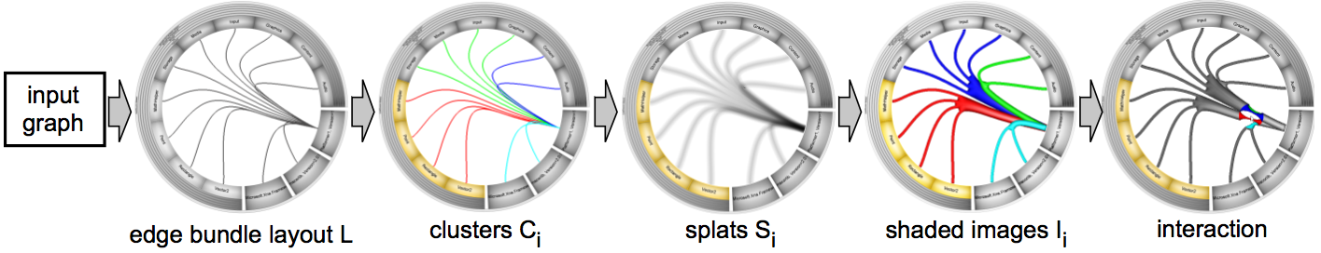
Multiscale HEB
Image-based edge bundles (IBEB) [Telea and Ersoy ‘10]
cluster similar edges
splat edges into a continuous density field
threshold field to get cluster shapes
render shapes with generalized shaded cushions
graph
layout
data
clustering
image
filtering
image
filtering
InfoVis
SciVis
discrete data
continuous data
www.cs.rug.nl/svcg

Slide 46
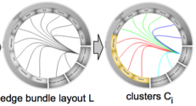
IBEB
Edge clustering
encode e_{i} = {e_{ij}} = { p_{1i} , … , p_{Ni} , d_{1i} , …, d_{Di} }
p_{ji} = j^{th} point along e_{i} (use N = 100 points)
d_{ji} = j^{th} data attribute of e_{i} (e.g. type)
graph is now a matrix M = {e_{ij} }
cluster the matrix using recursive bottom-up agglomerative clustering
create one cluster c_{i} for each edge e_{i} and C = {e_{i} }
define inter-cluster distance d(c_{i} , c_{j}) = Σ_{k}(e_{ki} - e_{kj})²
while C ≠ ∅
{c_{i}, c_{i}} = arg min_{c,c’∈C} d(c , c’)
C = C \ {c_{i} , c_{i}} U merge(c_{i} , c_{i})
merge() operation is a union in the simplest case merge(c_{i} , c_{i}) = {e | e ∈ c_{i} U c_{j}}
Efficient clustering library implementation: Cluster 3.0 (bosai.ims.u-tokio.ac.jp/~mdehoon/software/cluster)
www.cs.rug.nl/svcg

Slide 47
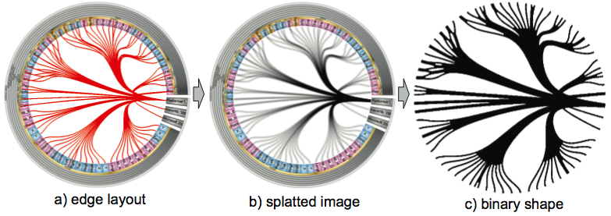
IBEB
From edge bundles to shapes
reduce discrete clusters (edge bundles) to continuous compact shapes
splat edges (see lecture 1)
threshold resulting density field
from now on, we’re in a continuous space ☺
efficiently implemented with OpenGL alpha textures
A. Telea, O. Ersoy, Image-based Edge bungles 2002
www.cs.rug.nl/svcg

Slide 48
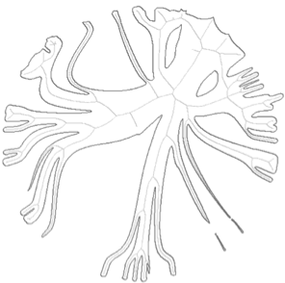
IBEB
Shape shading
extend the shaded cushions idea to bundle shapes (see lecture 1)
use shape skeletons
skeleton is locally centered within the shape
efficient computation: the AFMM method [Telea and Van Wijk ’02]
very similar to the method of [Costa and Cesar ’01]
A. Telea, J. J. van Wijk, An Augmented Fast Marching Method for Computing Skeletons and Centerlines, Proc. VisSym, 2002
www.cs.rug.nl/svcg

Slide 49




IBEB
Shape shading
compute a normalized distance field B between the shape boundary ∂Ω and its skeleton S
distance transform
T of ∂Ω
distance field B
B is
0 on ∂Ω
1 on S
smooth in-between
distance transform
D of S
A. Telea, J. J. van Wijk, An Augmented Fast Marching Method for Computing Skeletons and Centerlines, Proc. VisSym, 2002
www.cs.rug.nl/svcg

Slide 50




IBEB
Shape shading
interpret B as a height or luminance profile → shaded cushions!
different shading styles
vary hue, luminance, saturation

Slide 51

IBEB
Application – Software engineering
original HEB
A is connected to B…
…but how?
new IBEB
A₁ is connected to B₁…
A₂ is connected to B₂
www.cs.rug.nl/svcg

Slide 52
Attributes and structure
Recall from lecture 1
both nodes and edges in a graph can have several attributes
attributes can be numerical, ordinal, categorical, …
How to understand attributes?
table lens, parallel coordinates, scatter plots
good to compare attributes among themselves
do not correlate attributes with structure
treemaps
encode 1..3 attributes in cell visuals
correlate attributes with hierarchy, but not with association
node-link layouts
encode 1..2 attributes in node and link visuals
correlate attributes with hierarchy and/or association
hard to show more attributes on a structural (graph) visualization
open research problem (10..50 attributes?)
www.cs.rug.nl/svcg

Slide 53



Attributes and structure
Edge directions
particularly tricky case
node-link layouts: edges are thin shapes…
solution 1
hue gradient
from = red, to = green
overlaps: problematic
solution 2
luminance gradient
from = bright, to = dark
(on black background)
overlaps: problematic
solution 3
oriented textures
need thick edges (bundles)
close bundles: problematic
from
to
www.cs.rug.nl/svcg

Slide 54

Attributes and structure
Use the 3rd dimension: city metaphor
xy plane: structure (treemap)
z axis: metrics
color + xy size : extra metrics
JHotDraw system (www.jhotdraw.org)
visualized with CodeCity (www.usi.inf.ch/phd/wettel/codecity.html)
R. Wettel, M. Lanza, Program comprehension through software habitability, IEEE ICPC, 2007 see also Codstruction tool (codstruction.wordpress.com)
www.cs.rug.nl/svcg

Slide 55


3D vs 2D
3D pro’s
one extra dimension to show data with
some 3D layouts are intuitive (code city)
3D wow factor
3D con’s
perspective deformation
occlusion
loss of orientation
complex interaction
developers familiar with 2D tools
B
A
which is taller? A or B?
there’s perspective foreshortening
how do you describe this image to your colleague?
can you tell what is inside?
can you follow an edge?
RA. Teyseyre, M. Campo, An Overview of 3D Software Visualization, IEEE TVCG 15(1), 2009
www.cs.rug.nl/svcg

Slide 56
Software structure: Diagrams
Diagrams
design or architectural information
can be also generated from source code (reverse engineering)
UML (Unified Modeling Language)
most accepted (but not only) diagram notation in the engineering community
class
object
sequence
use case
statecharts
activity
package
component
deployment
variants of node-link layouts
special semantics (icons, positions, text annotations)
most often drawn by hand
UML 1.0 most known and used
UML 2.0 and beyond: more powerful but quite complex
The UML Notation Standard (www.uml.org)
www.cs.rug.nl/svcg

Slide 57
UML Diagrams
add software metrics to support e.g. software quality analysis
show several metrics per element with icons
metric encoded as icon size, shape, color
compare metrics of the same element
compare metrics across elements
The MetricView tool
A: visualization
B: UML browser
C: metric layout
D: metric data
MetricView tool (www.cs.rug.nl/svcg/SoftVis/ArchiVis)
www.cs.rug.nl/svcg

Slide 58


UML Diagrams
smoothly navigate between structure and metrics
use transparency
diagram: opaque
metrics: transparent
diagram: transparent
metrics: opaque
structure
metrics
MetricView tool (www.cs.rug.nl/svcg/SoftVis/ArchiVis)
www.cs.rug.nl/svcg

Slide 59


UML Diagrams
2D vs 3D again
same idea as CodeCity but
use different xy layout
can also show associations
flip scene to smoothly navigate from 2D to 3D view
2D view (=3D seen from above)
3D view
MetricView tool (www.cs.rug.nl/svcg/SoftVis/ArchiVis)
www.cs.rug.nl/svcg

Slide 60


Annotations
special type of attribute
text (comments, notes, …)
areas of interest
Areas of interest (AOIs)
group of diagram elements sharing some common property
“all thread-safe components”
“all classes using graphics resources”
“stuff we work on in the next release”
very important in design phase
typically sketched on whiteboard in design sessions
www.cs.rug.nl/svcg

Slide 61


Areas of interest
how to draw AOIs on software diagrams
automatically
in a way that resembles human drawings
Design requirements
element vs AOI relations should be clear (inside or outside)
multiple, overlapping AOIs
drawing should be rounded and ‘fuzzy’
AOIs should not interfere with diagram
minimize clutter
social network visualization [Theron et al ‘08]
AOIs drawn as convex hulls of their elements
clustered graph visualization [Gross et al ‘00]
AOIs drawn isosurfaces of a distance function
T. Sprenger, R. Brunella, M. Gross, H-BLOB: A hierarchi-cal visual clustering method using implicit surfaces, IEEE Visualization, 2000
R. Theron, R. Santamaria, J. Garcia, D. Gomez, Overlapper: visualization of interconnected social groups, Graph Drawing, 2008

Slide 62





Areas of interest
texture-based solution
texture splatting
example diagram (110 classes, 11 areas)
problems at overlaps!

Slide 63

Areas of interest
solution with deformable contours
compute convex hull (like [Theron et al ‘08])
sample contour uniformly
move contour inwards with uniform speed
stop when close to elements
resample to keep uniform point density
H. Byelas, A. Telea, Visualization of areas of interest in software architecture diagrams, ACM SOFTVIS, 2006
www.cs.rug.nl/svcg

Slide 64

Areas of interest
same diagram as before
areas look quite natural
use blending to emphasize area overlaps
www.cs.rug.nl/svcg

Slide 65


Is the drawing ‘good’?
User evaluation
35 users were given one UML diagram and list of areas to draw
separately a computer-generated AOI drawing was made
users were given a pair of human-drawn AOI and the computer-drawn AOI
asked to solve some problems on the two drawings
asked which drawing they preferred and why
overall, most (but not all) human drawings seen as slightly better
Which do you think is human-drawn, which is machine-drawn?
H. Byelas, A. Telea, Towards visual realism in drawing areas of interest on architecture diagrams, J. Vis. Lang. Comp., 20(2), 2009

Slide 66

Areas and attributes
OK, we know how to draw good-looking areas of interest
how to add extra attributes so we can
compare values of all elements in one area
compare values of an element present in different areas
compare one value across all elements in diagram
?
?
?
?
www.cs.rug.nl/svcg

Slide 67



Metric lens
embed a small table lens within each diagram element
scroll/sort columns in sync for all elements
Graphical editor
areas = subsystems
LOC and complexity metrics
most classes have low metrics
1 large, complex class (hard to maintain code!)
luckily, not in the system core

Slide 68


Area metrics
still defined on elements, but related to areas
power consumption for all elements in “power critical” area
algorithmic speed for all elements in “video processing” area…
how to visualize
variation of a metric over a single area
correlation of the area metrics of one element contained in several areas?
also, improve the tasks of detecting
which are all areas containing a given element
which are all elements in one given area
use textures
Voronoi diagram of area
color Voronoi cells by element metric
create a smooth variation
use Laplacian diffusion

Slide 69


Area metrics
use a different texture pattern for each area
pattern ‘weaving’ indicates overlaps
technique well-know from cartography (economic indicators on a land map)
+
=
H. Byelas, A. Telea, Visualizing metrics on areas of interest in software architecture diagrams, IEEE PacificVis, 2009
www.cs.rug.nl/svcg

Slide 70


Area metrics
further emphasize areas with shaded cushions
for an area Ω, define a height signal h : Ω → R², h|_{∂Ω} = 0, h|_{Ω \ ∂Ω} = 1
iteratively filter h with Laplacian filter
re-normalize h to [0..1] after each iteration
use h as shading profile
www.cs.rug.nl/svcg

Slide 71



Area metrics
can use either continuous or discrete colormaps, with/without smoothing
continuous: smooth results; but what is the meaning of an interpolated metric between two elements??
discrete: no ‘false’ values created; but visual result is more noisy
continuous rainbow colormap
continuous (smooth) metrics
discrete colormaps
discrete metrics
www.cs.rug.nl/svcg

